Slide 1
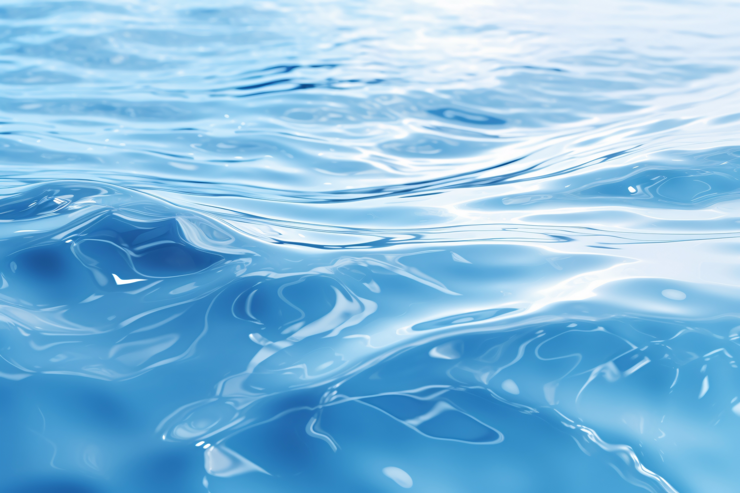
AquaGator:
Autonomous Underwater Robot for Water Quality Measurement of Northwest Pennsylvania Lakes
Pallas-Athena Cain*, Josephine Reiter, Benedek Kaibas, Janyl Jumadinova

Slide 2
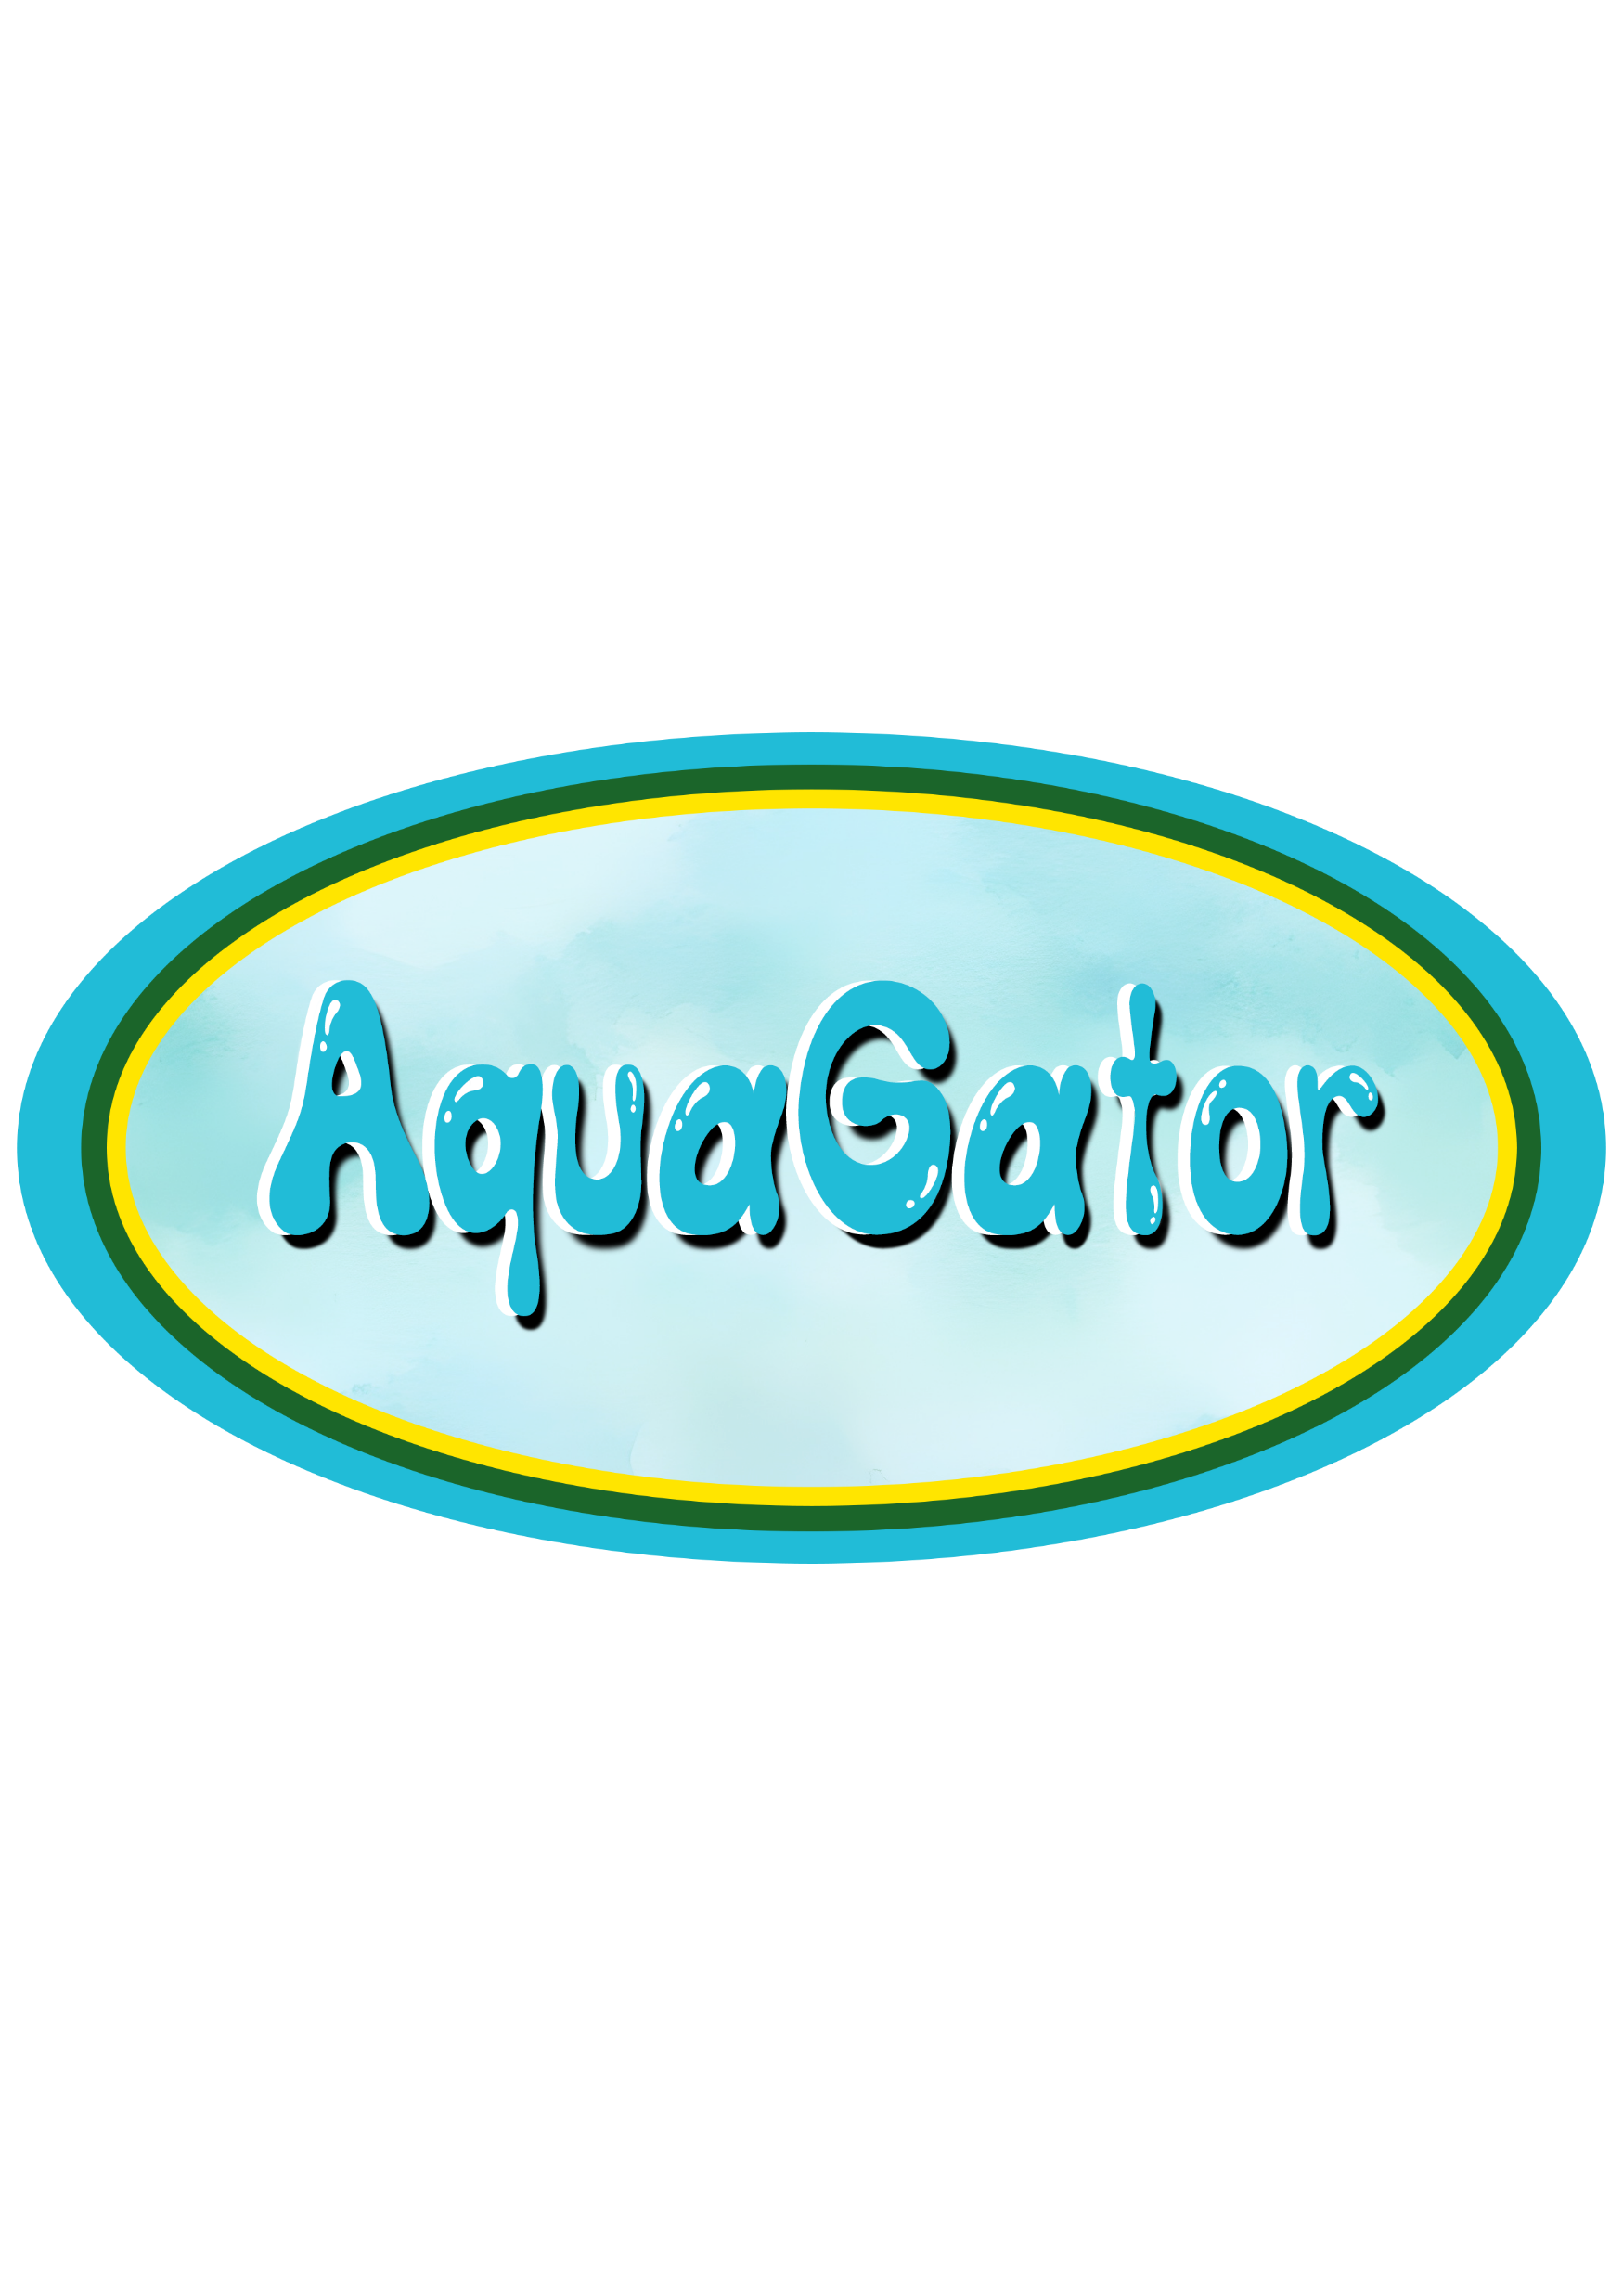
INTRODUCTION
Goal: Automate tethered ROVs for water quality management of Northwestern Pennsylvania Lakes
Allegheny College, Watershed Conservation Research Center, Crawford County Conservation District
ROV stands for remotely operated vehicle
Monitor pH, conductivity, dissolved oxygen, oxygen-reduction potential, and temperature
Depth sensor to track values at specific depths
Notes:
ROVs are often used for places where it is hard to get a physical person such in space or underwater. Crawford County Conservation District – Bryan Pilarcik is the Watershed Specialist Goal: Develop tethered ROVs for water quality management of Northwestern Pennsylvania Lakes
ROV stands for remotely operated vehicle
Monitor pH, conductivity, dissolved oxygen, oxygen-reduction potential, and temperature
Depth sensor to track values at specific depths

Slide 3
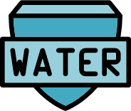
MOTIVATIONS
Data Visualization
Mitigate Labor
Cost Effective Design
Data Collection
Predictions for Preventative Care

Slide 4
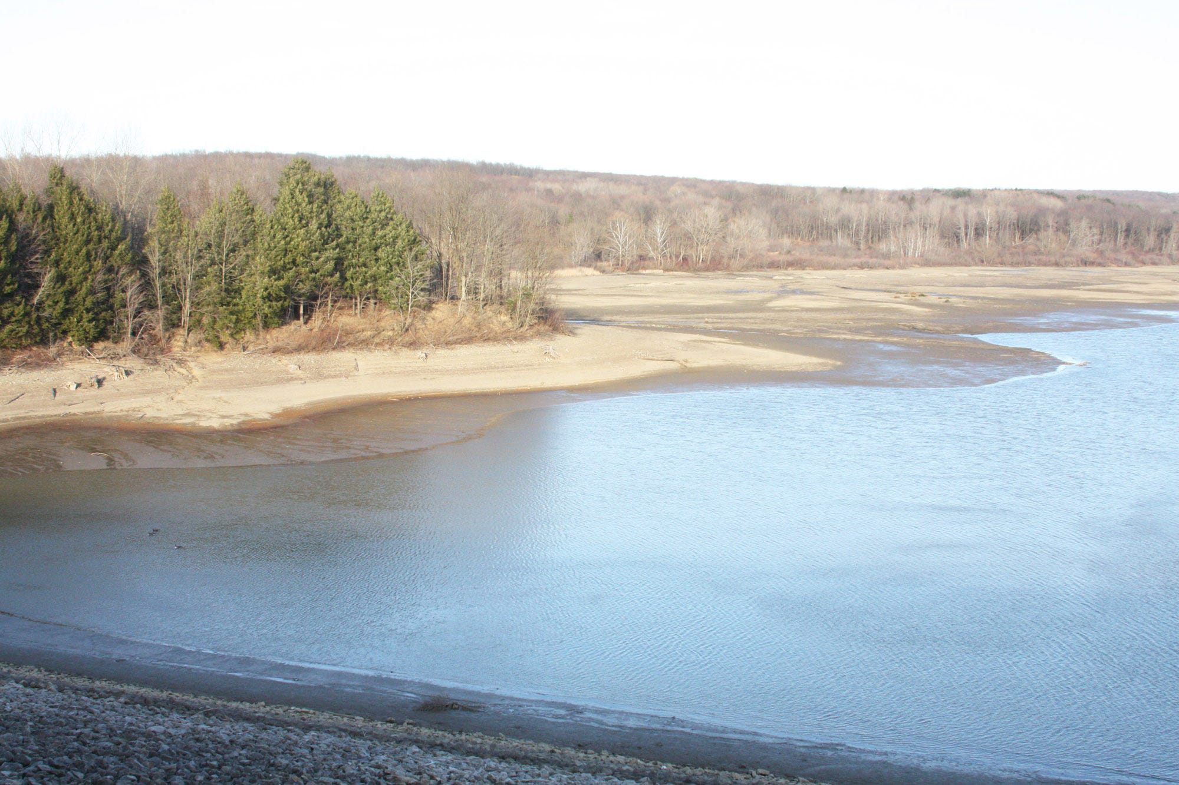
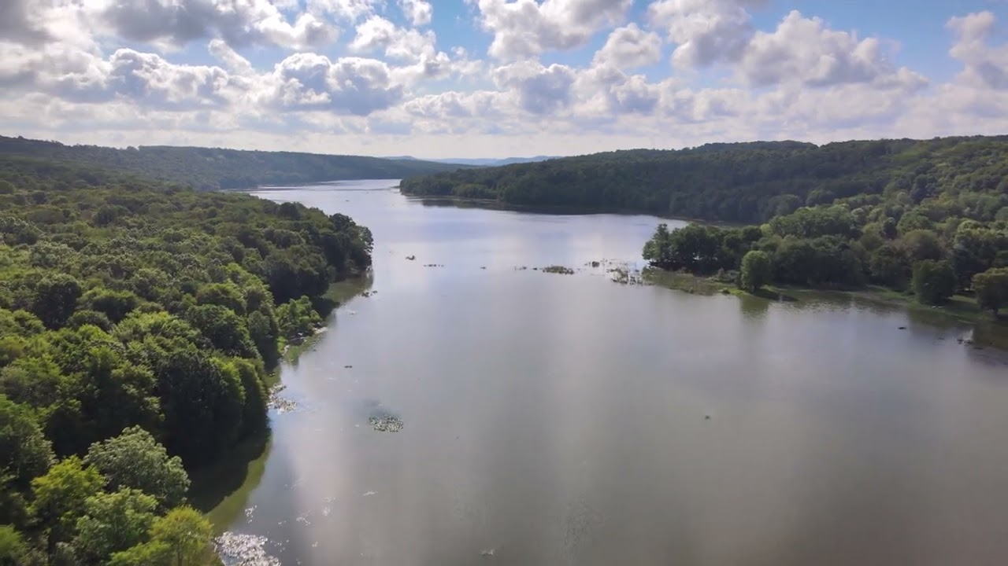
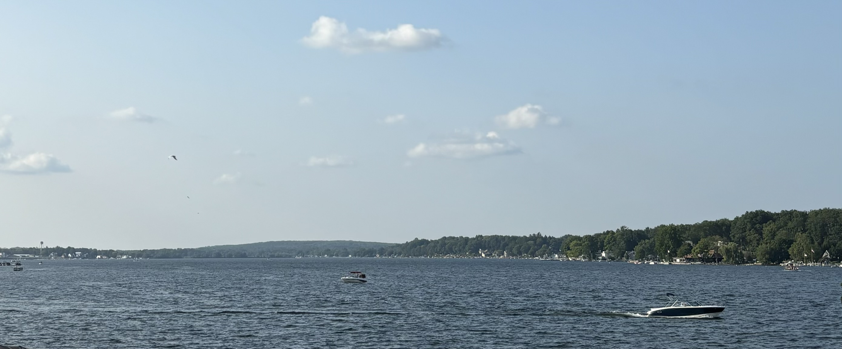
[1]
[2]
[4]
[3]

Slide 5
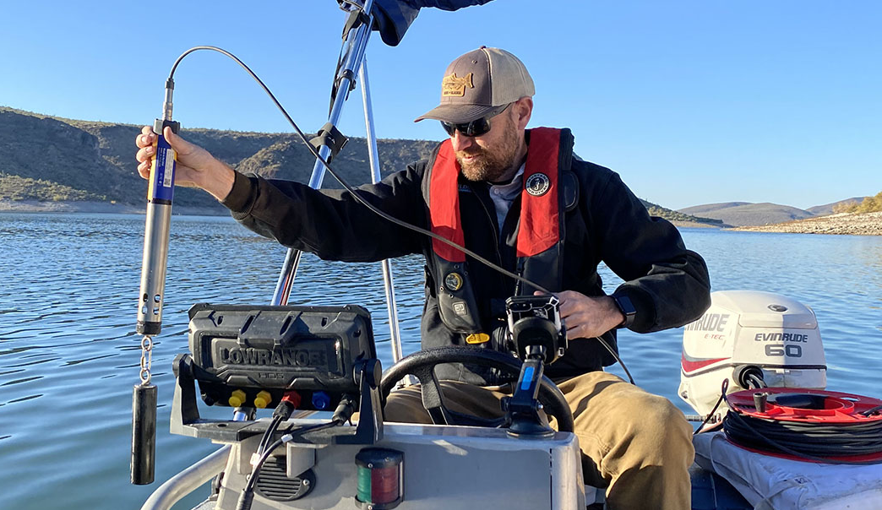
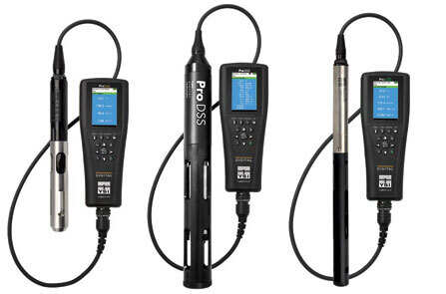
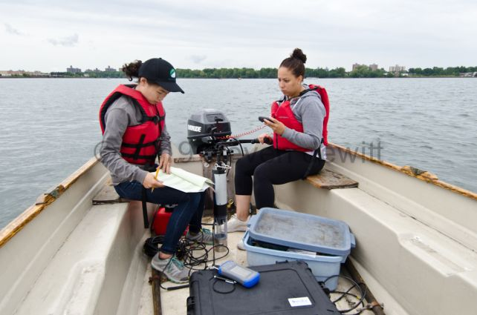
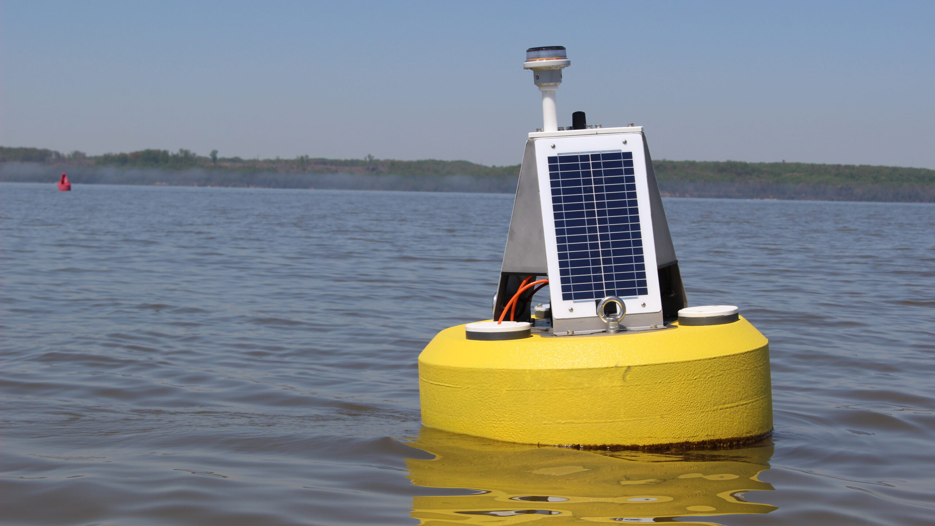
[5]
[7]
[6]
[8]

Slide 6
METHOD
Control
System
Display Software
Sensor System
Frame
Automation

Slide 7
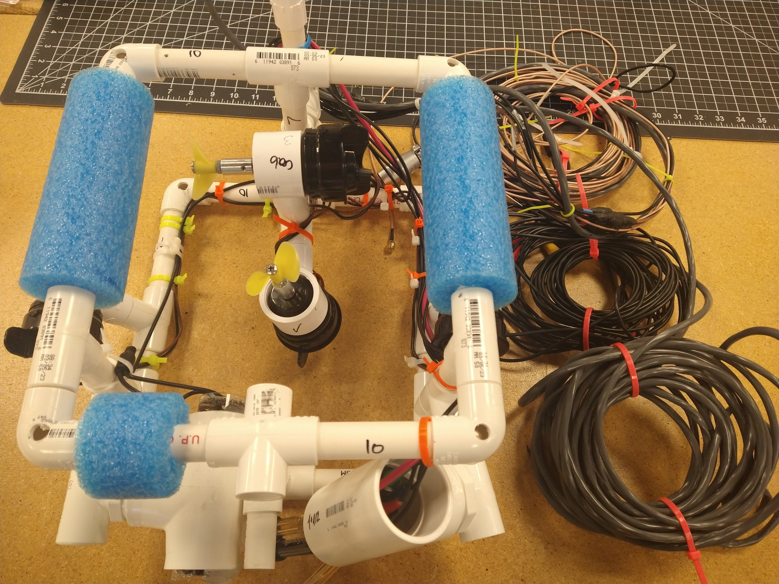
FRAME
Orthogonal Design
PVC
Buoyancy System

Slide 8
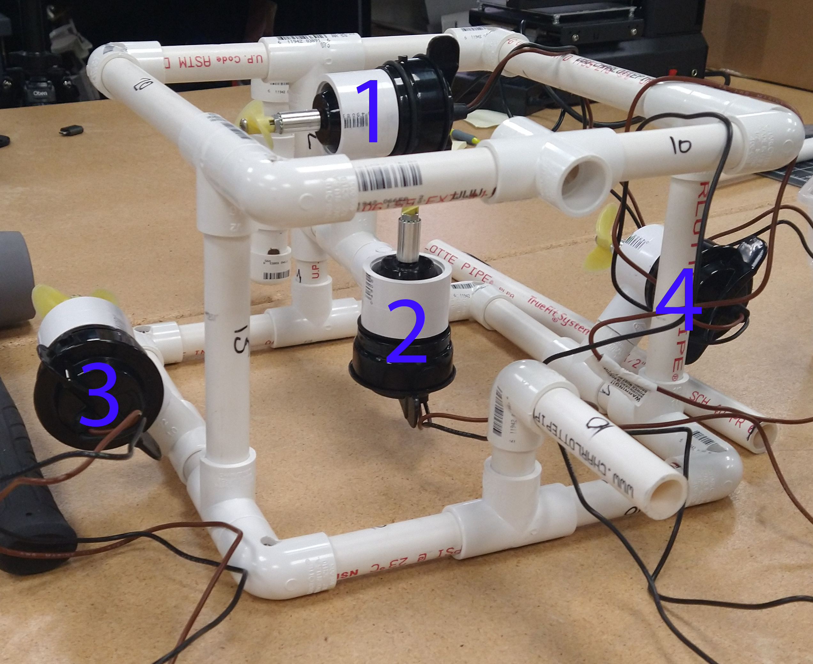
CONTROL SYSTEM
4 Motors
CCW and CW
Ranges of motion: surge, heave, yaw, and sway
Surge – Motors 3 and 4
Heave – Motor 2
Yaw – Motor 1
Sway – Motor 3 and 4 (one faster than the other)

Slide 9
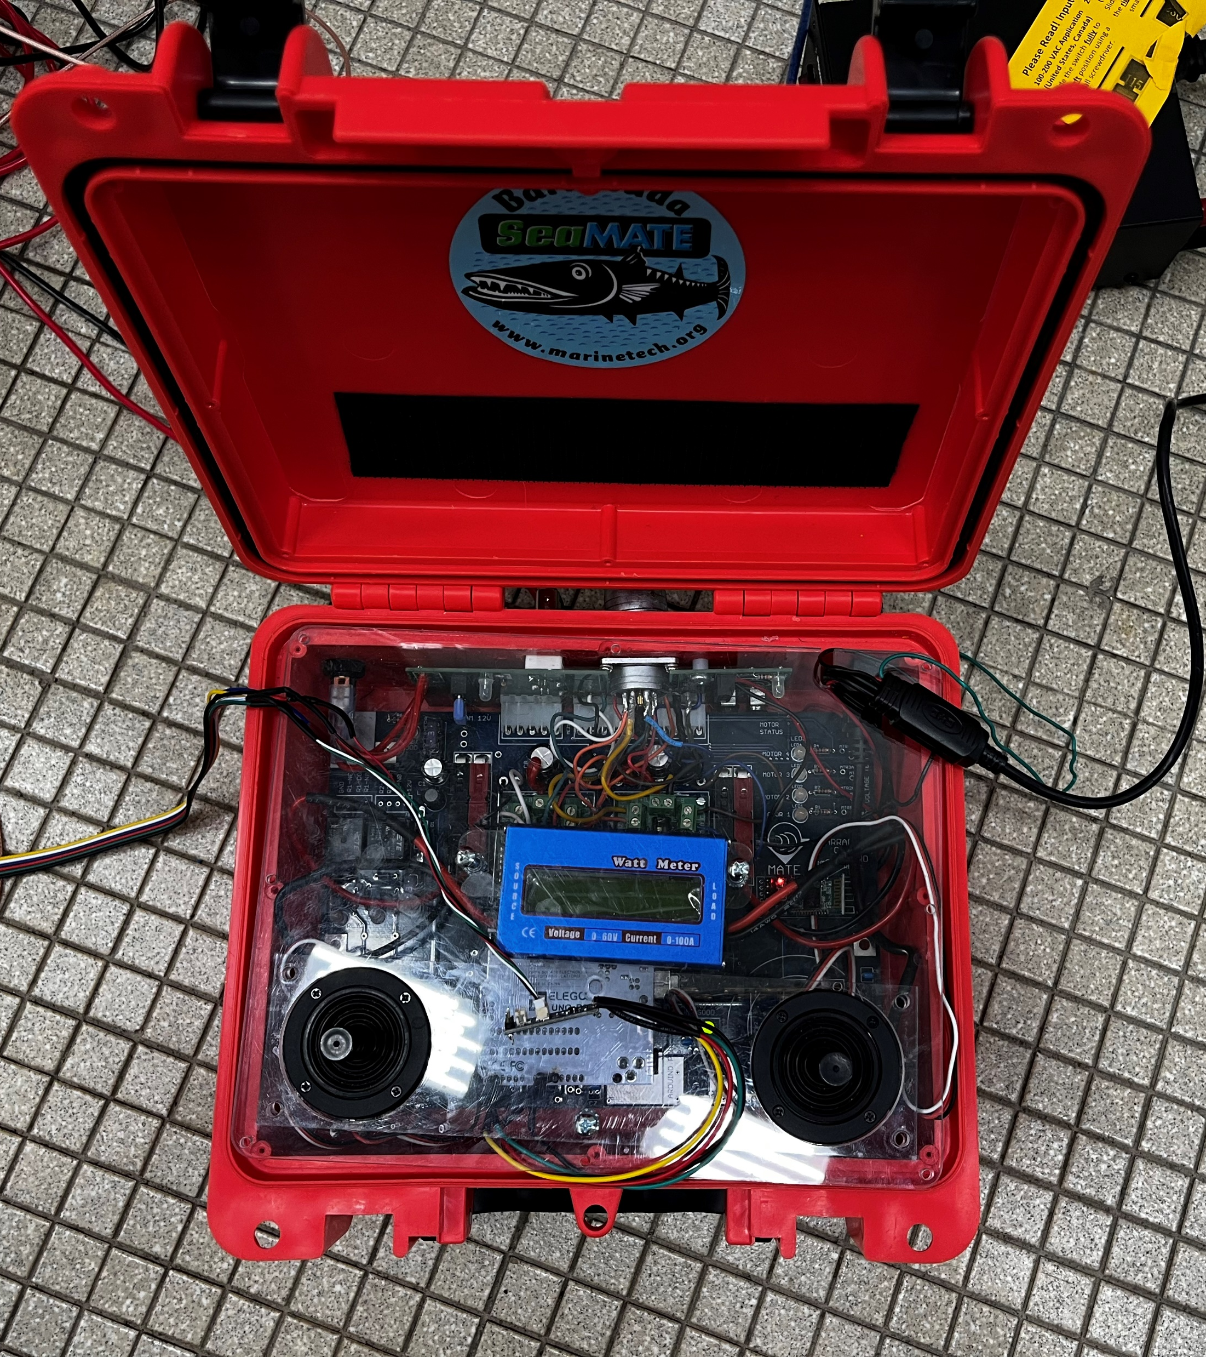
CONTROL SYSTEM
Motors are controlled by an Arduino
Control box with joysticks and video monitor
Waterproof camera
Manually operated option(eye)
Automation option

Slide 10
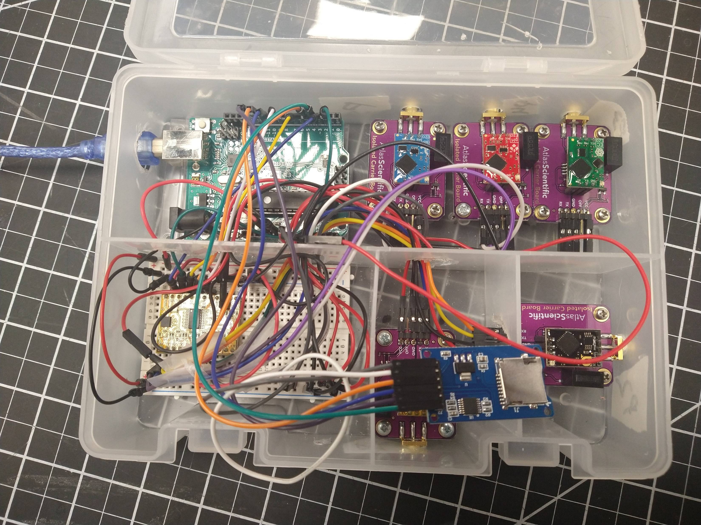
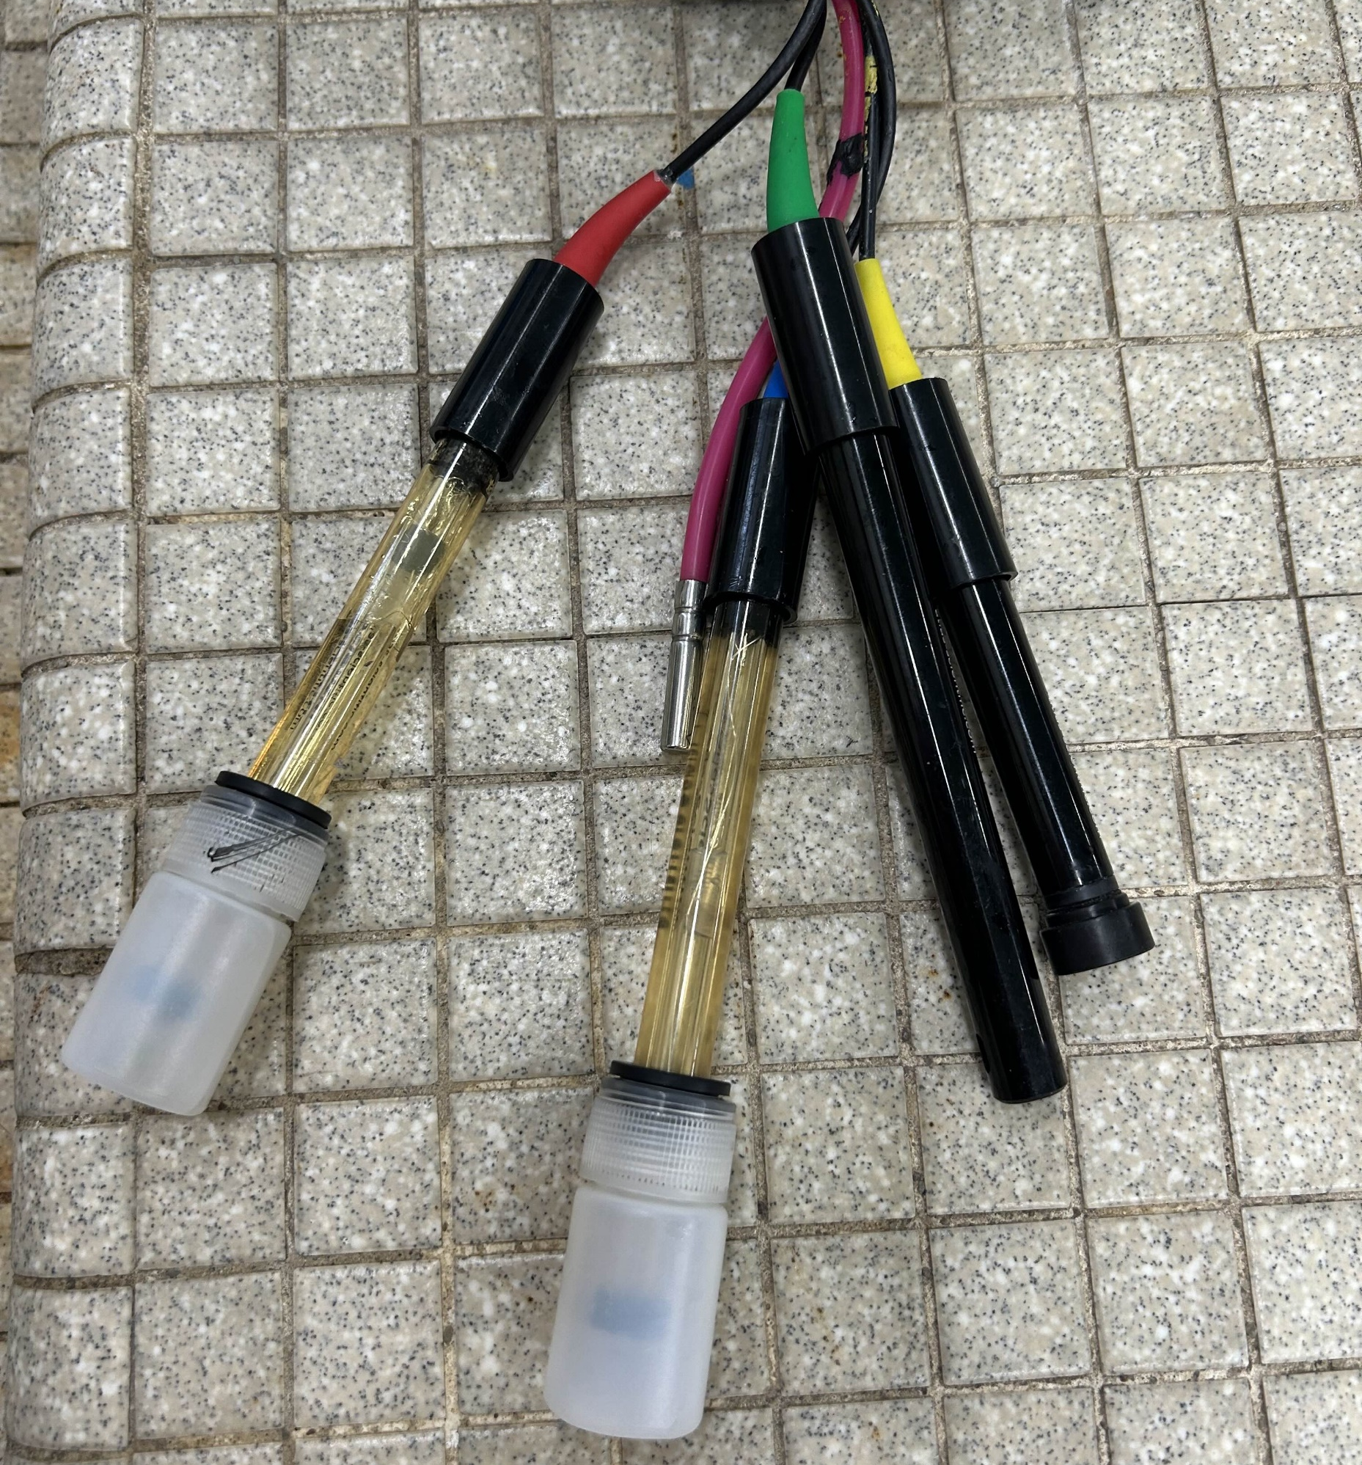
SENSOR SYSTEM
Track pH, conductivity, dissolved oxygen, oxygen-reduction potential, and temperature
Probes attached to the robot that connect to sensor box
2nd Arduino gathers sensor output one after another continuously

Slide 11
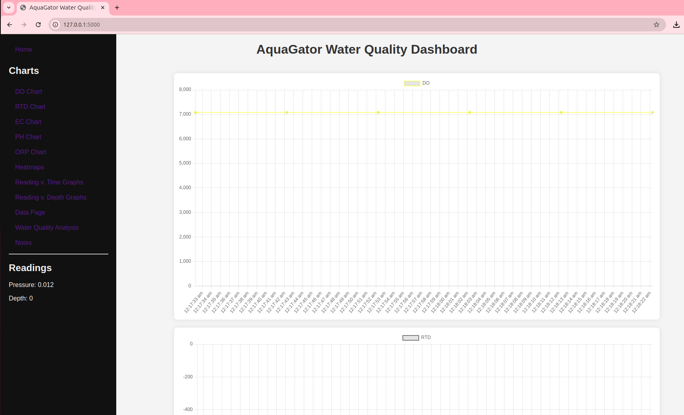
DISPLAY AND DATA COLLECTION SOFTWARE
Live Graphs
Aggregate Graphs
Heatmaps
CSV
Note Taking
Analysis
SD Card Option

Slide 12
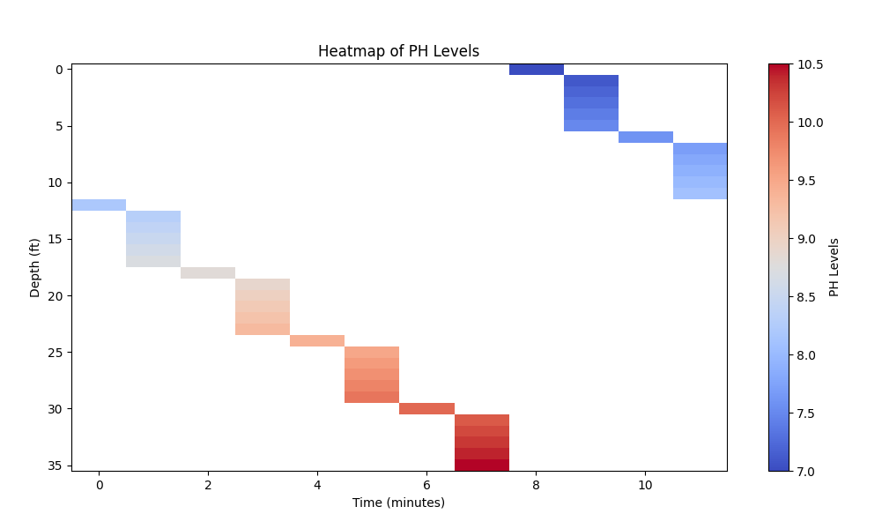
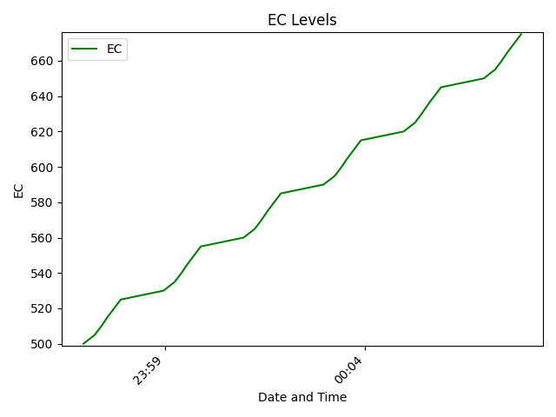
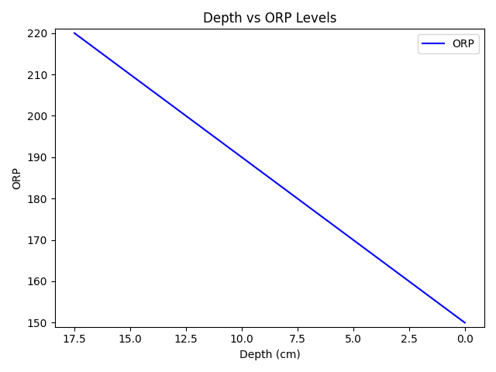
EXAMPLE GRAPHS

Slide 13
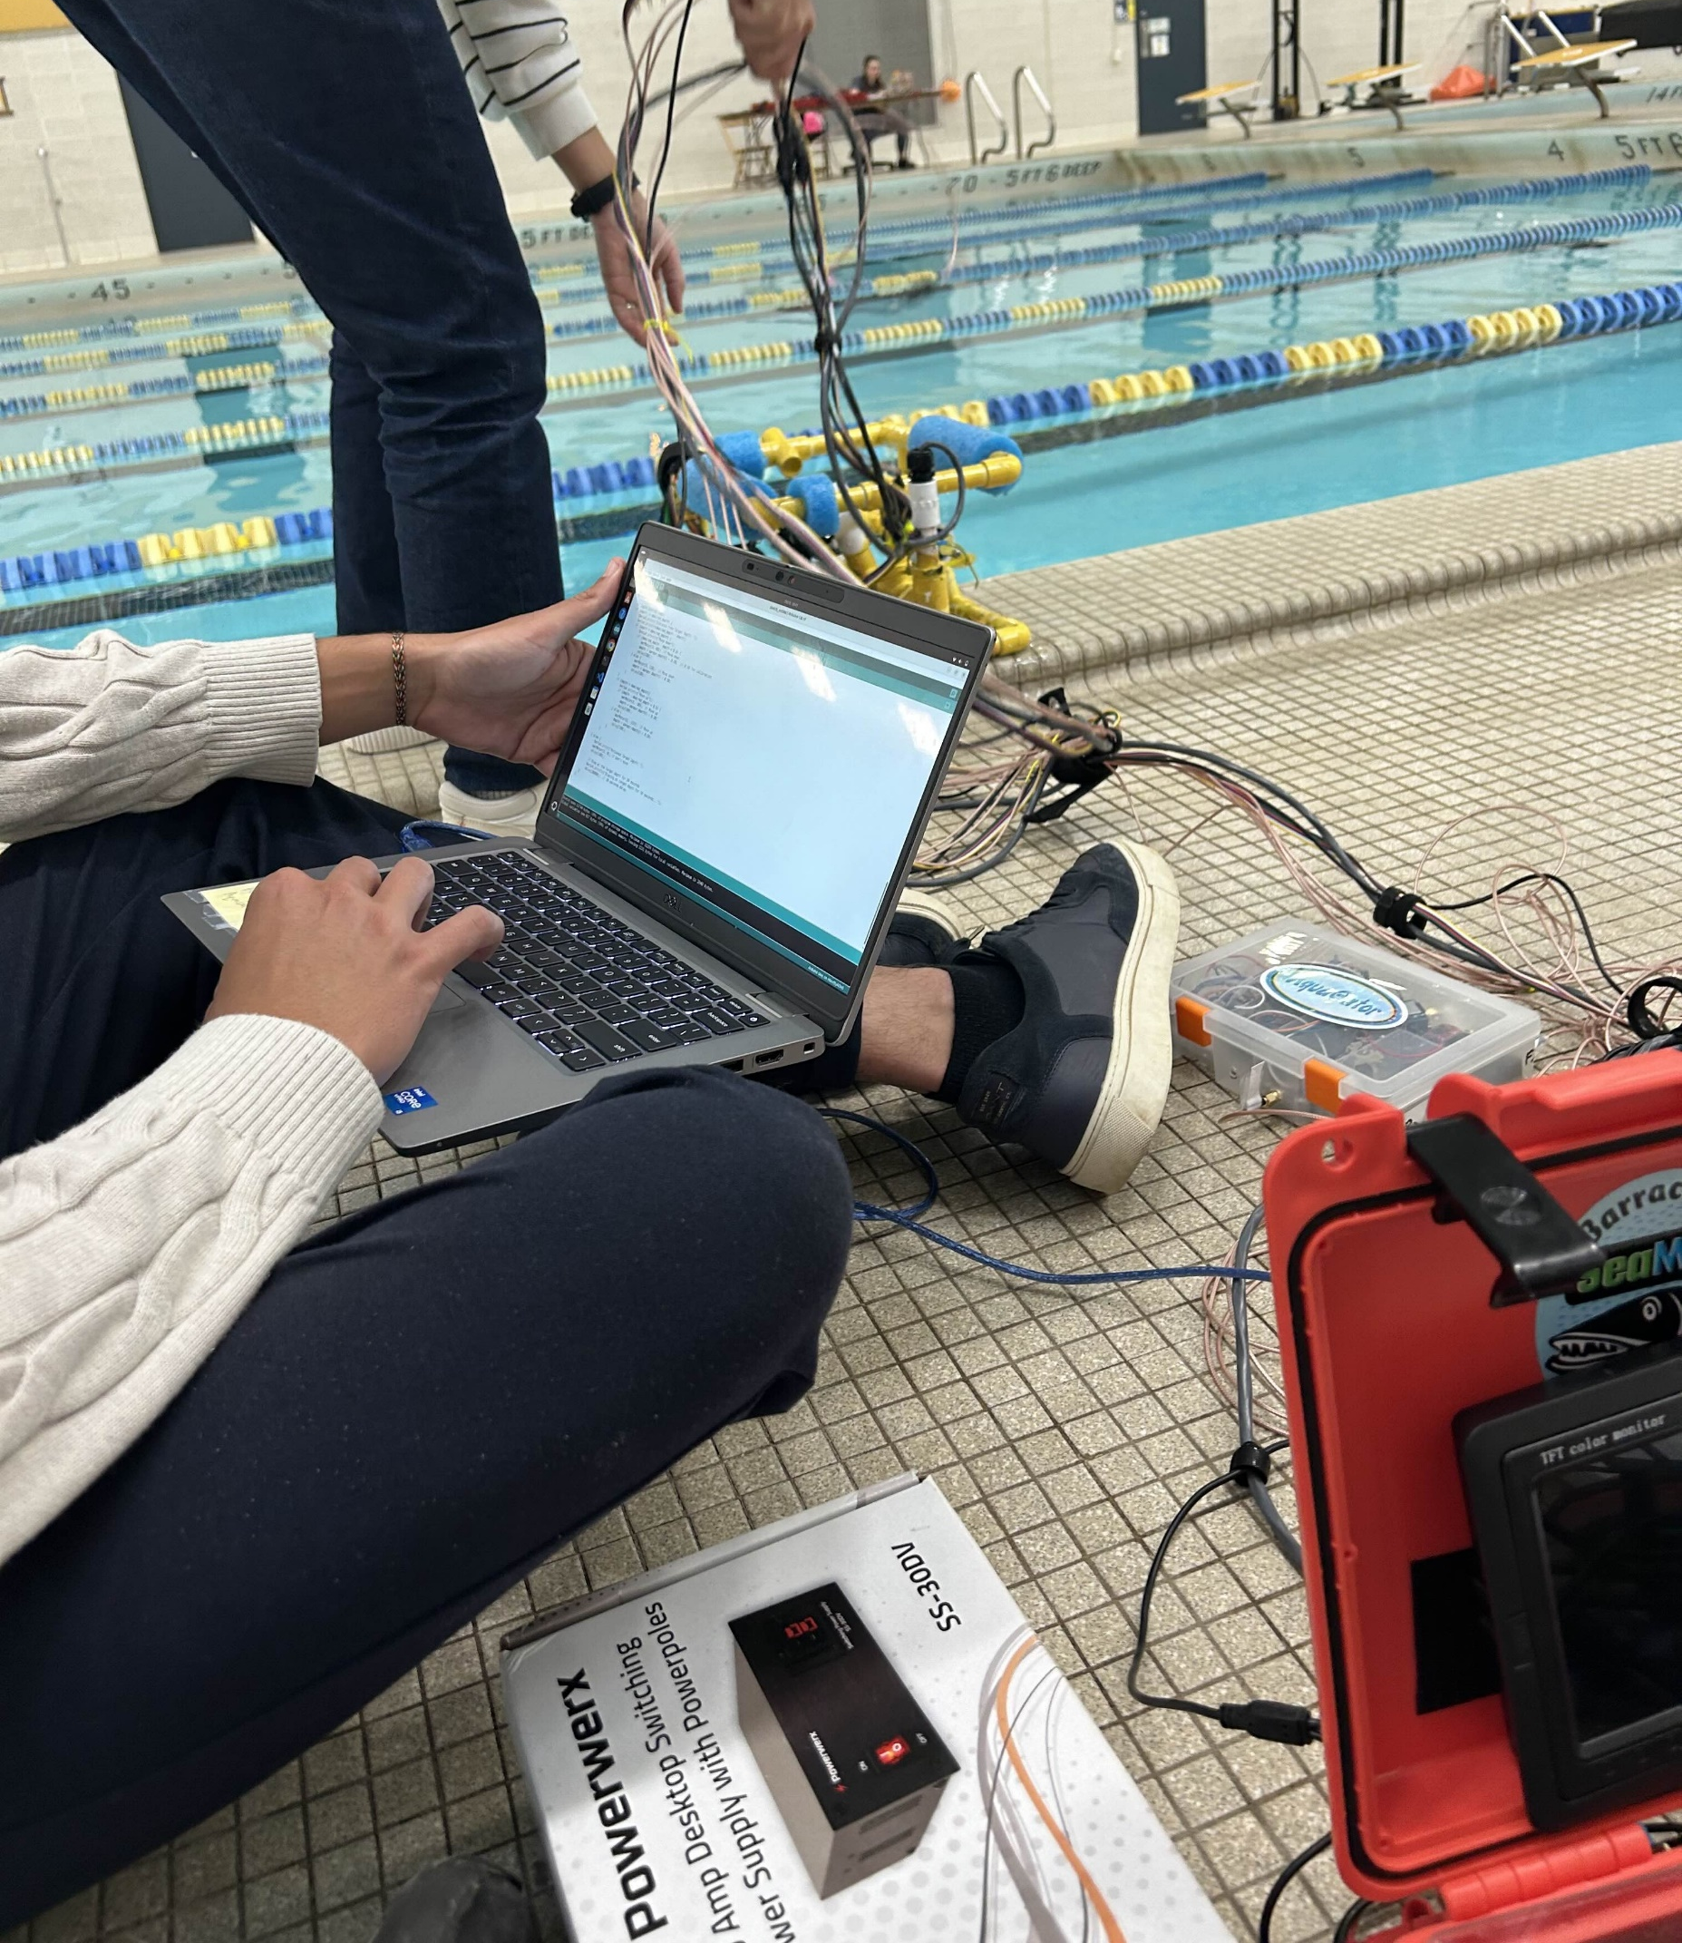
AUTOMATION
Vertical Movement
Meters and feet
Maintain depth
Measurements over time

Slide 14
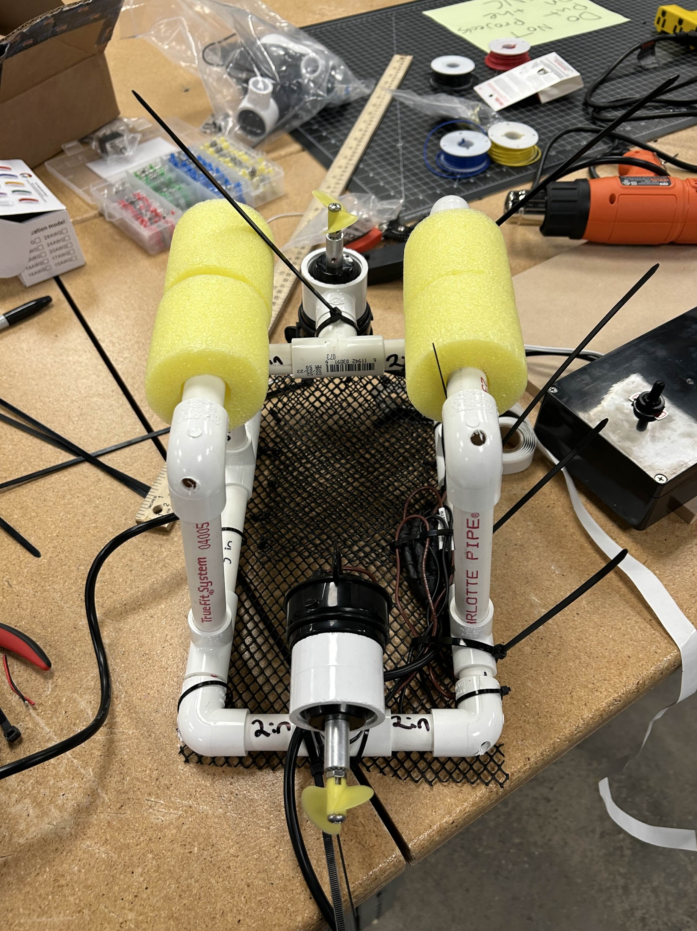
EDUCATION
Underwater Robotics Curriculum K-12
Enrichment Lessons
Elementary Outreach

Slide 15
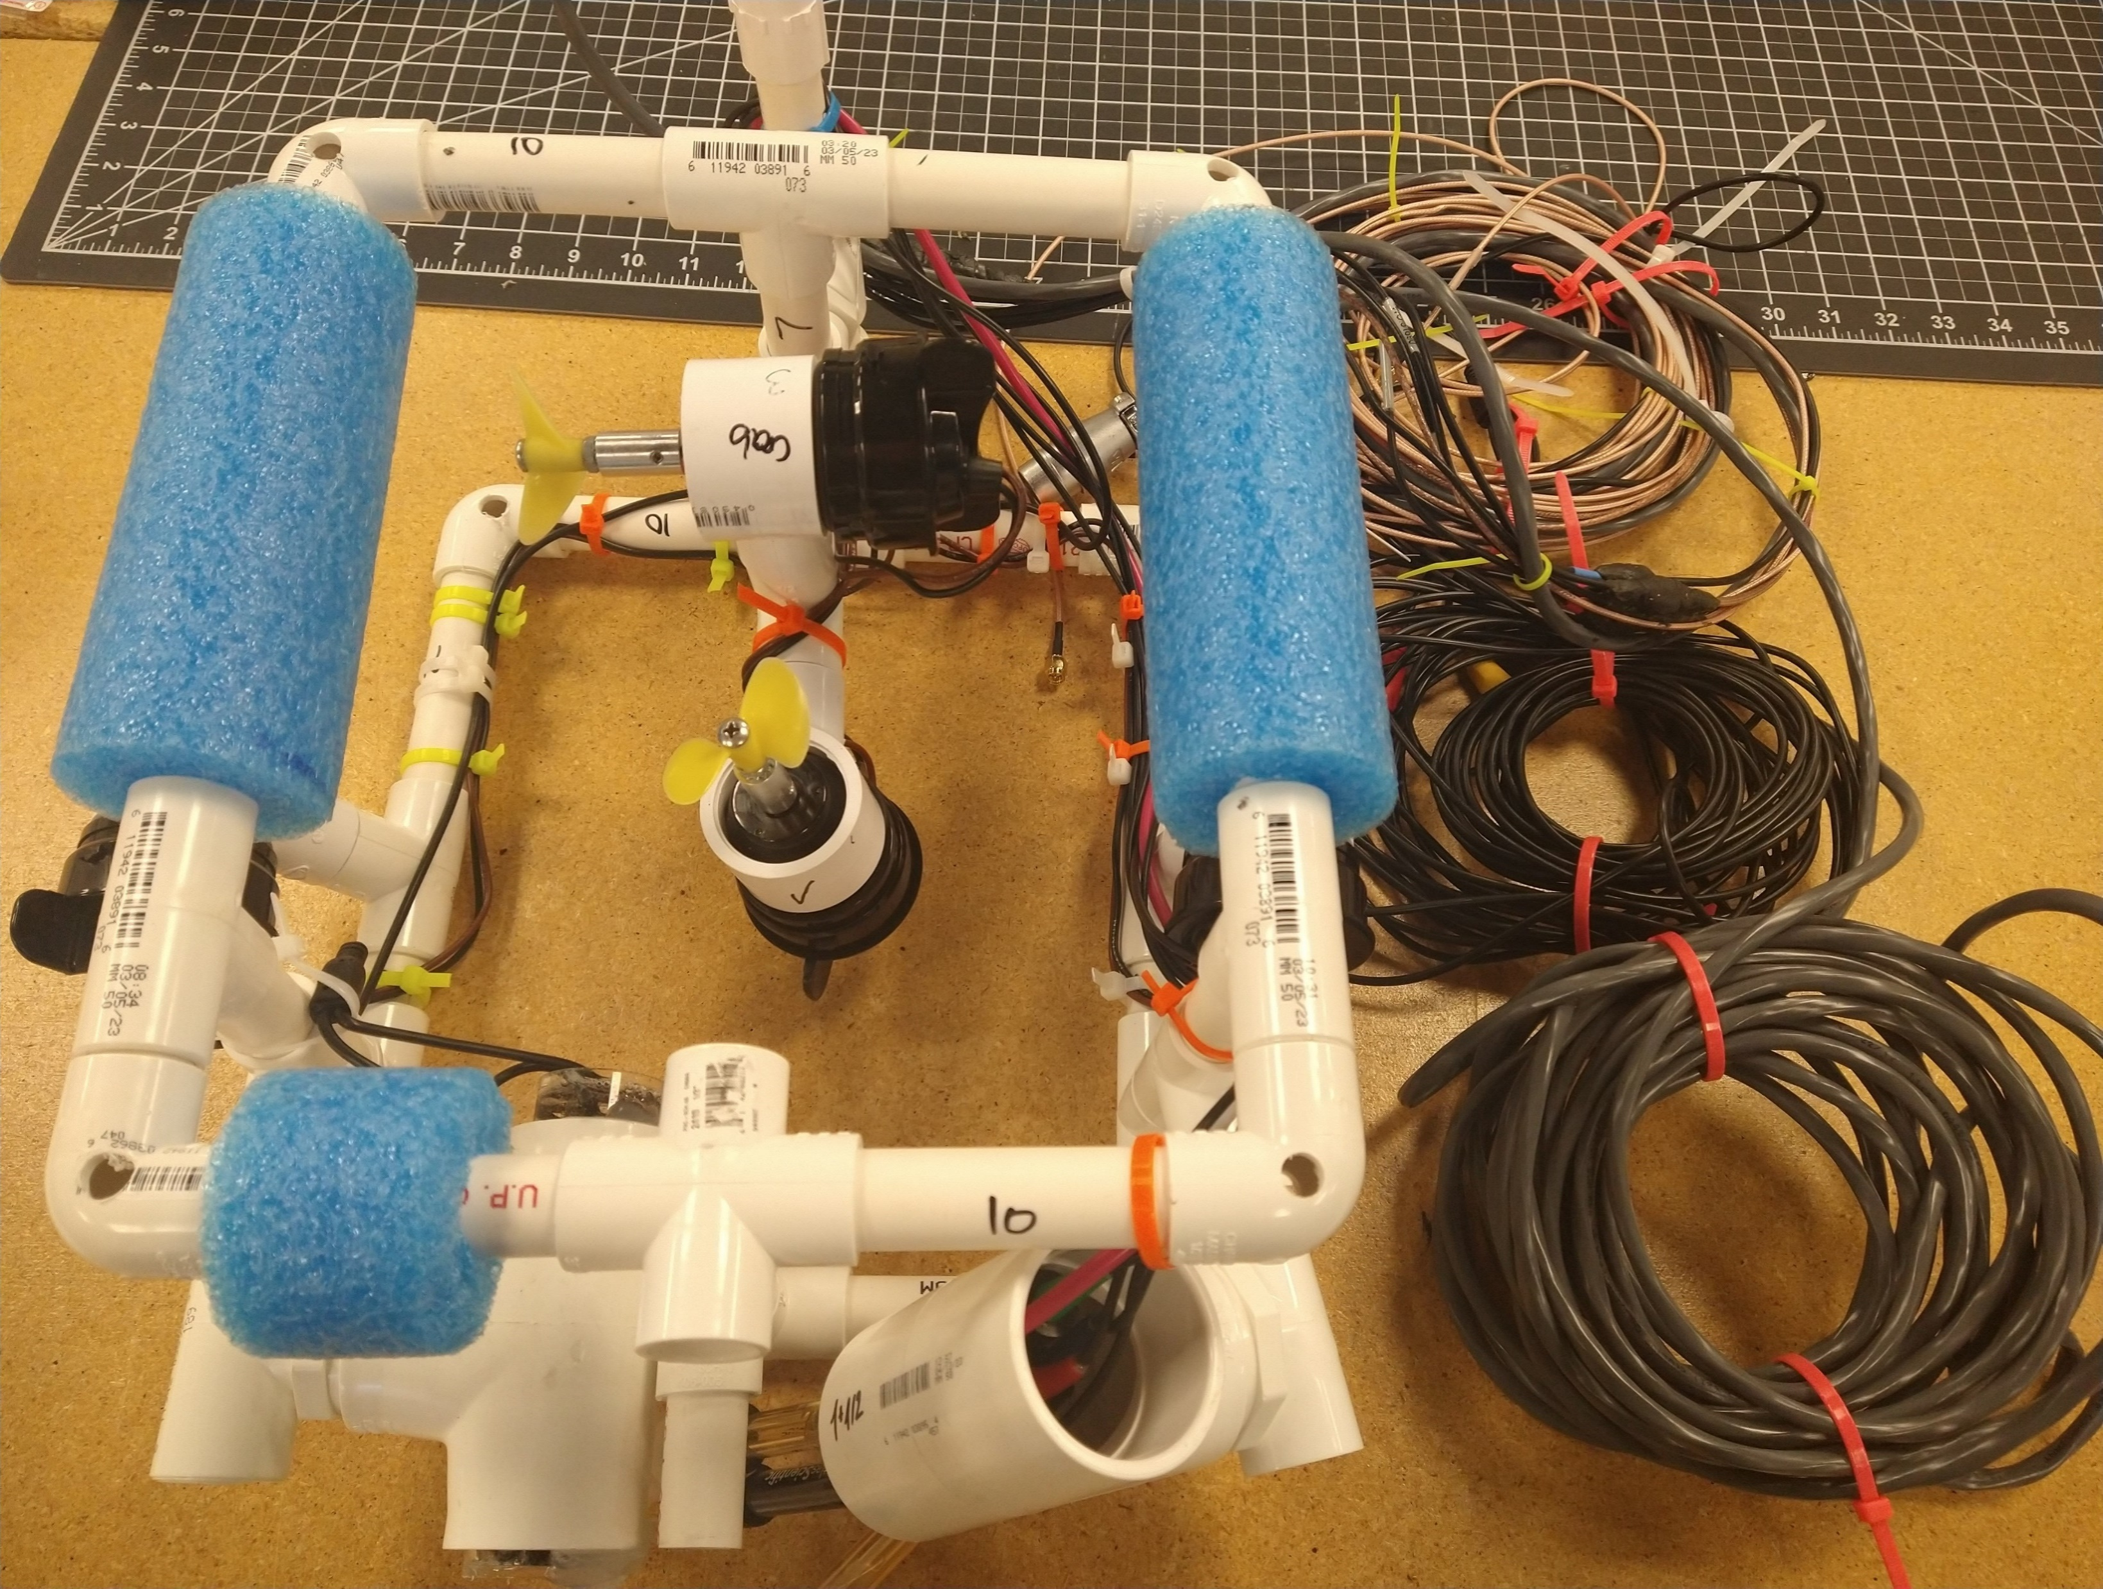
OUTCOMES
Improve Automation Accuracy
Testing
Woodcock Lake
Pymatuning Lake
Allegheny College Pool
Sensor Calibration
Fixing Hardware
Build Instructions

Slide 16
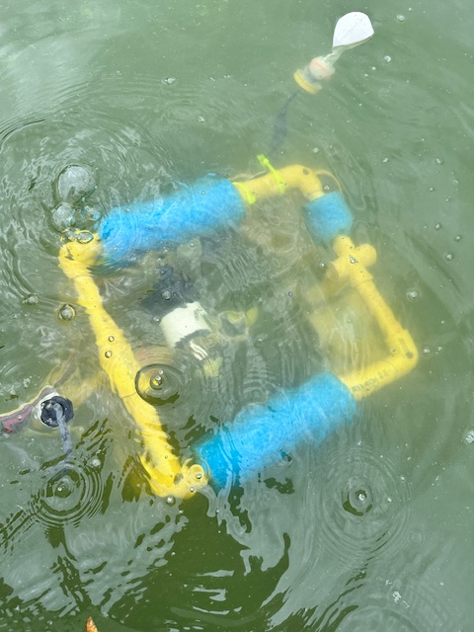
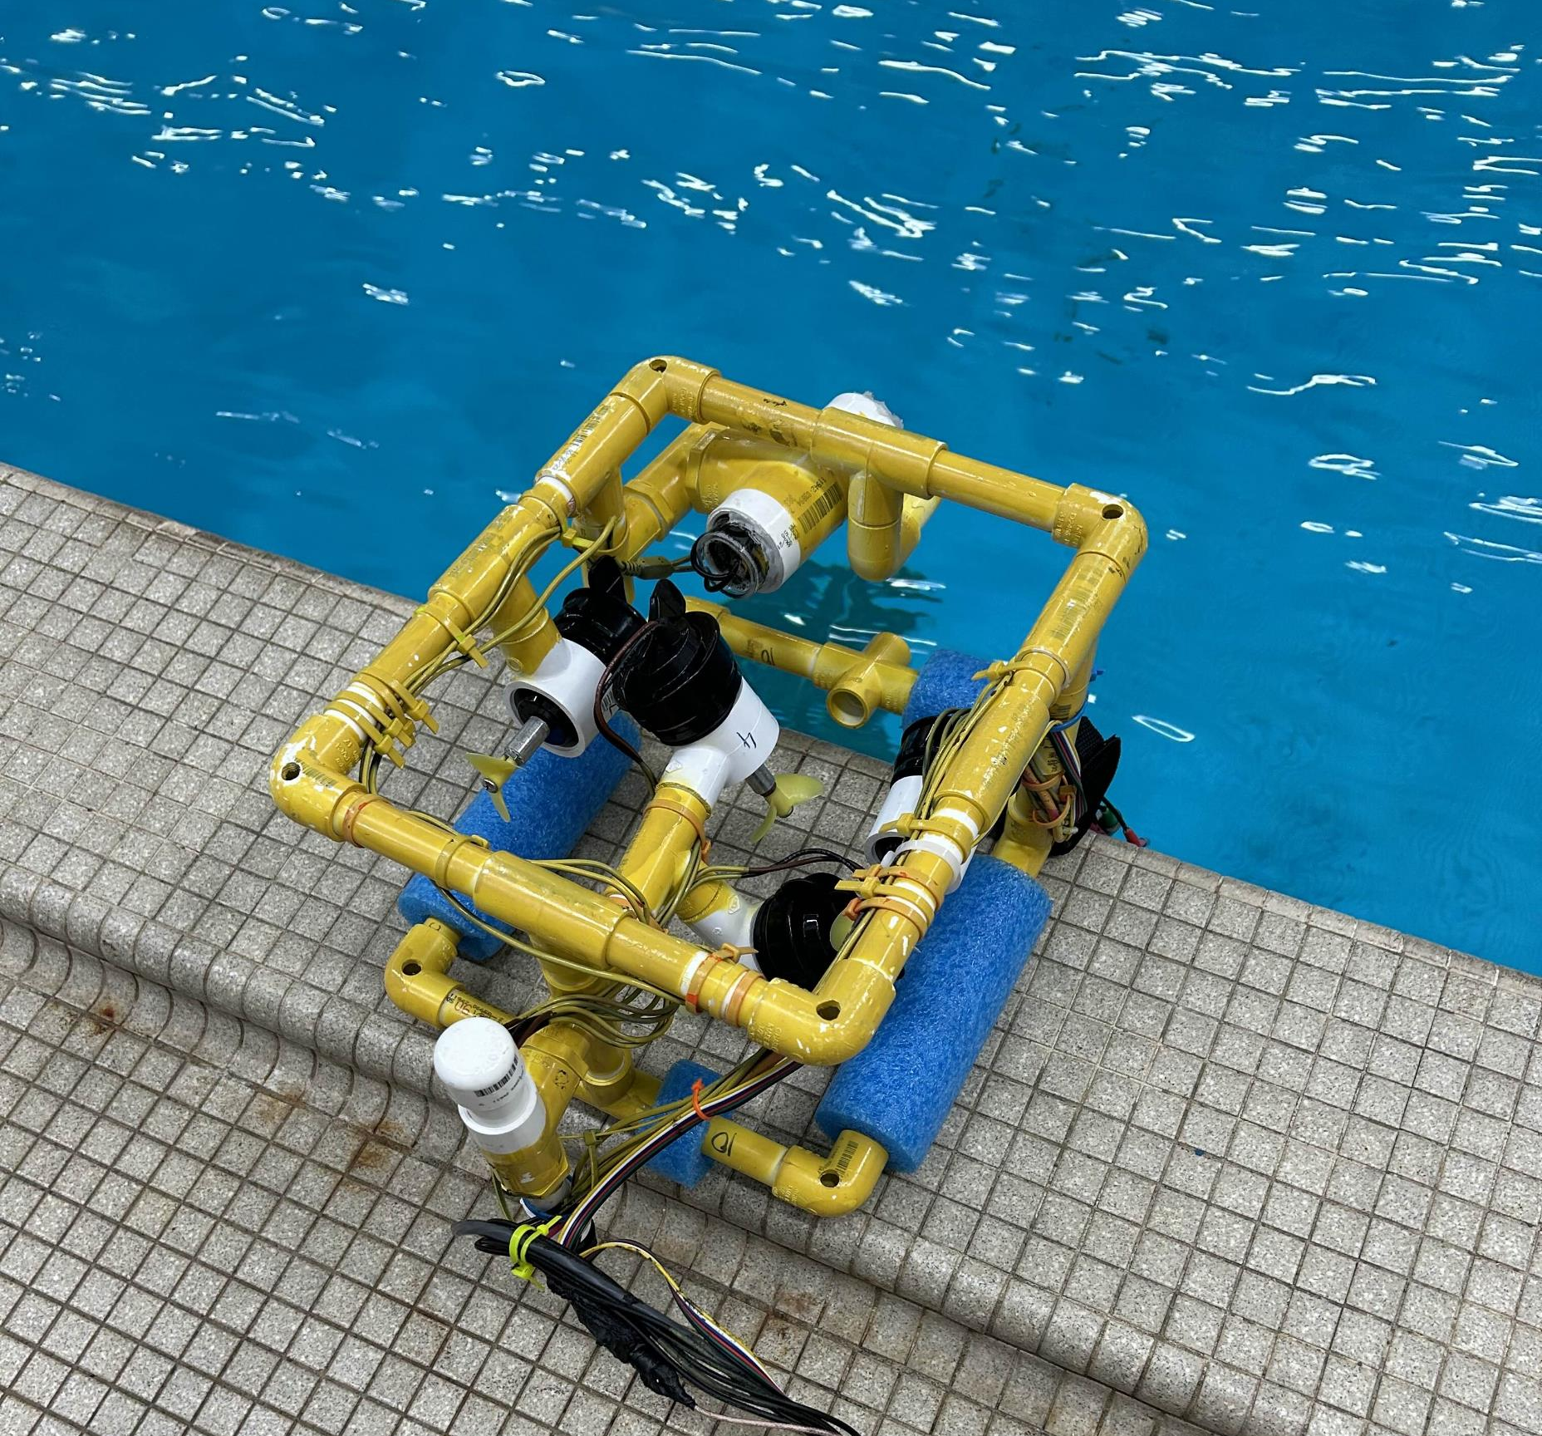
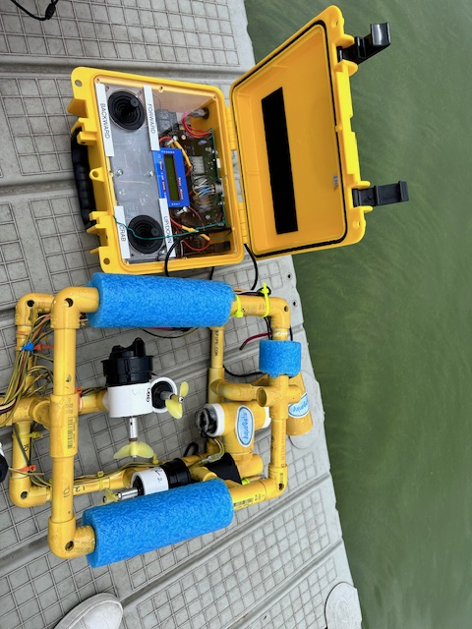

Slide 17
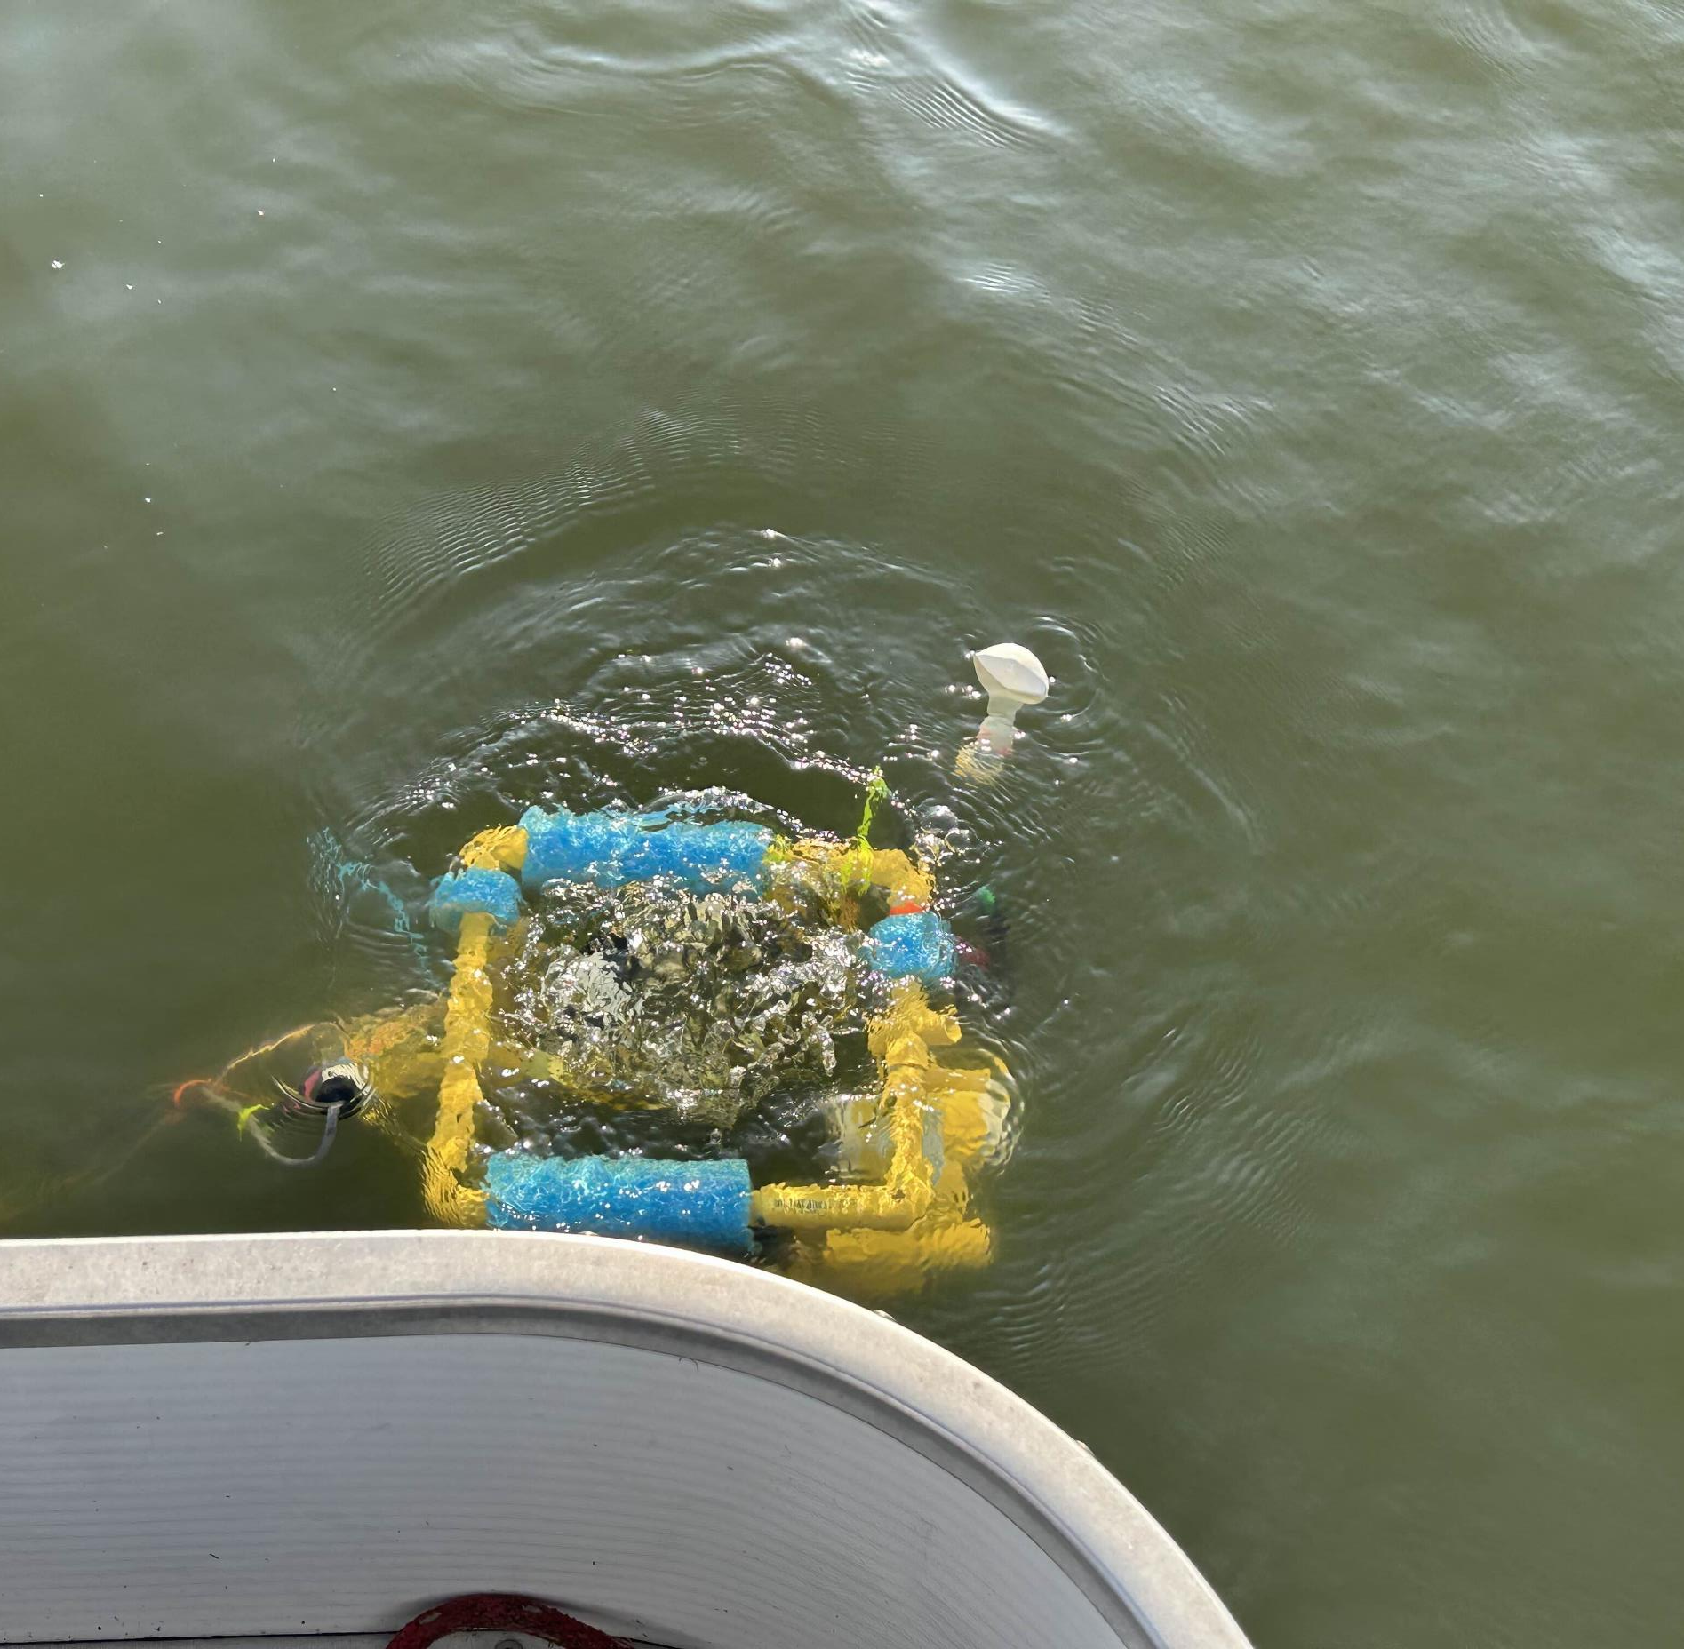
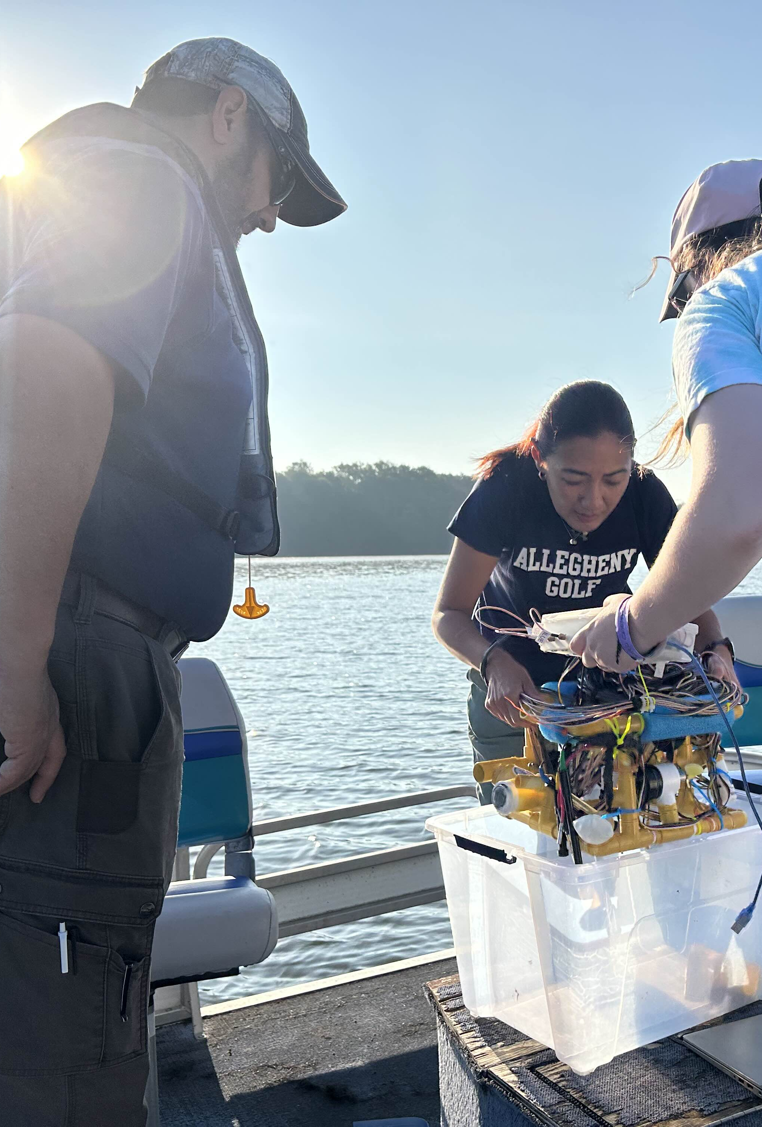
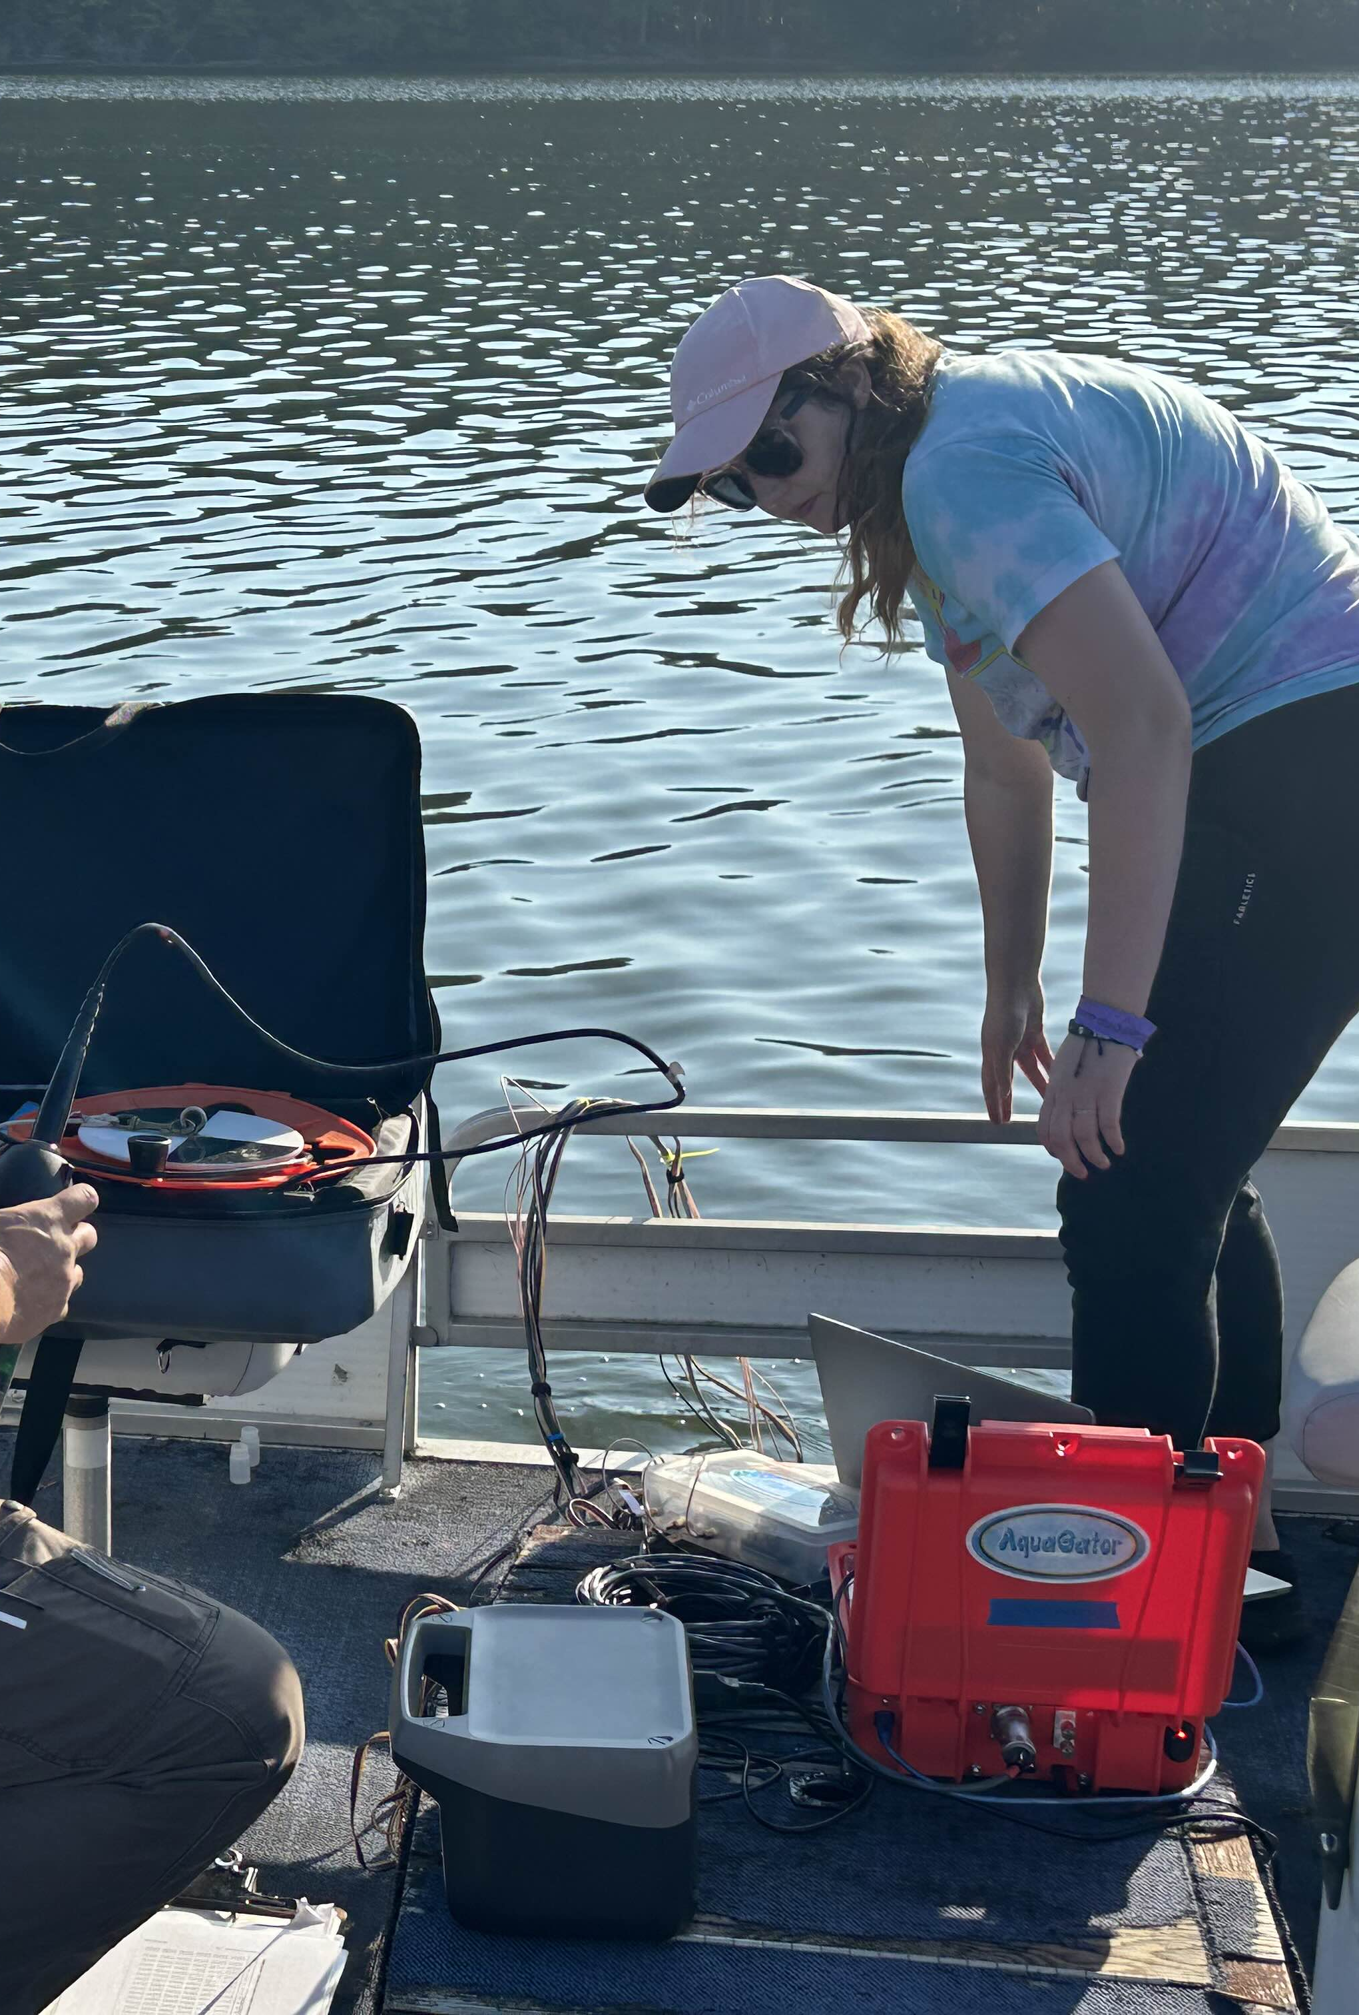
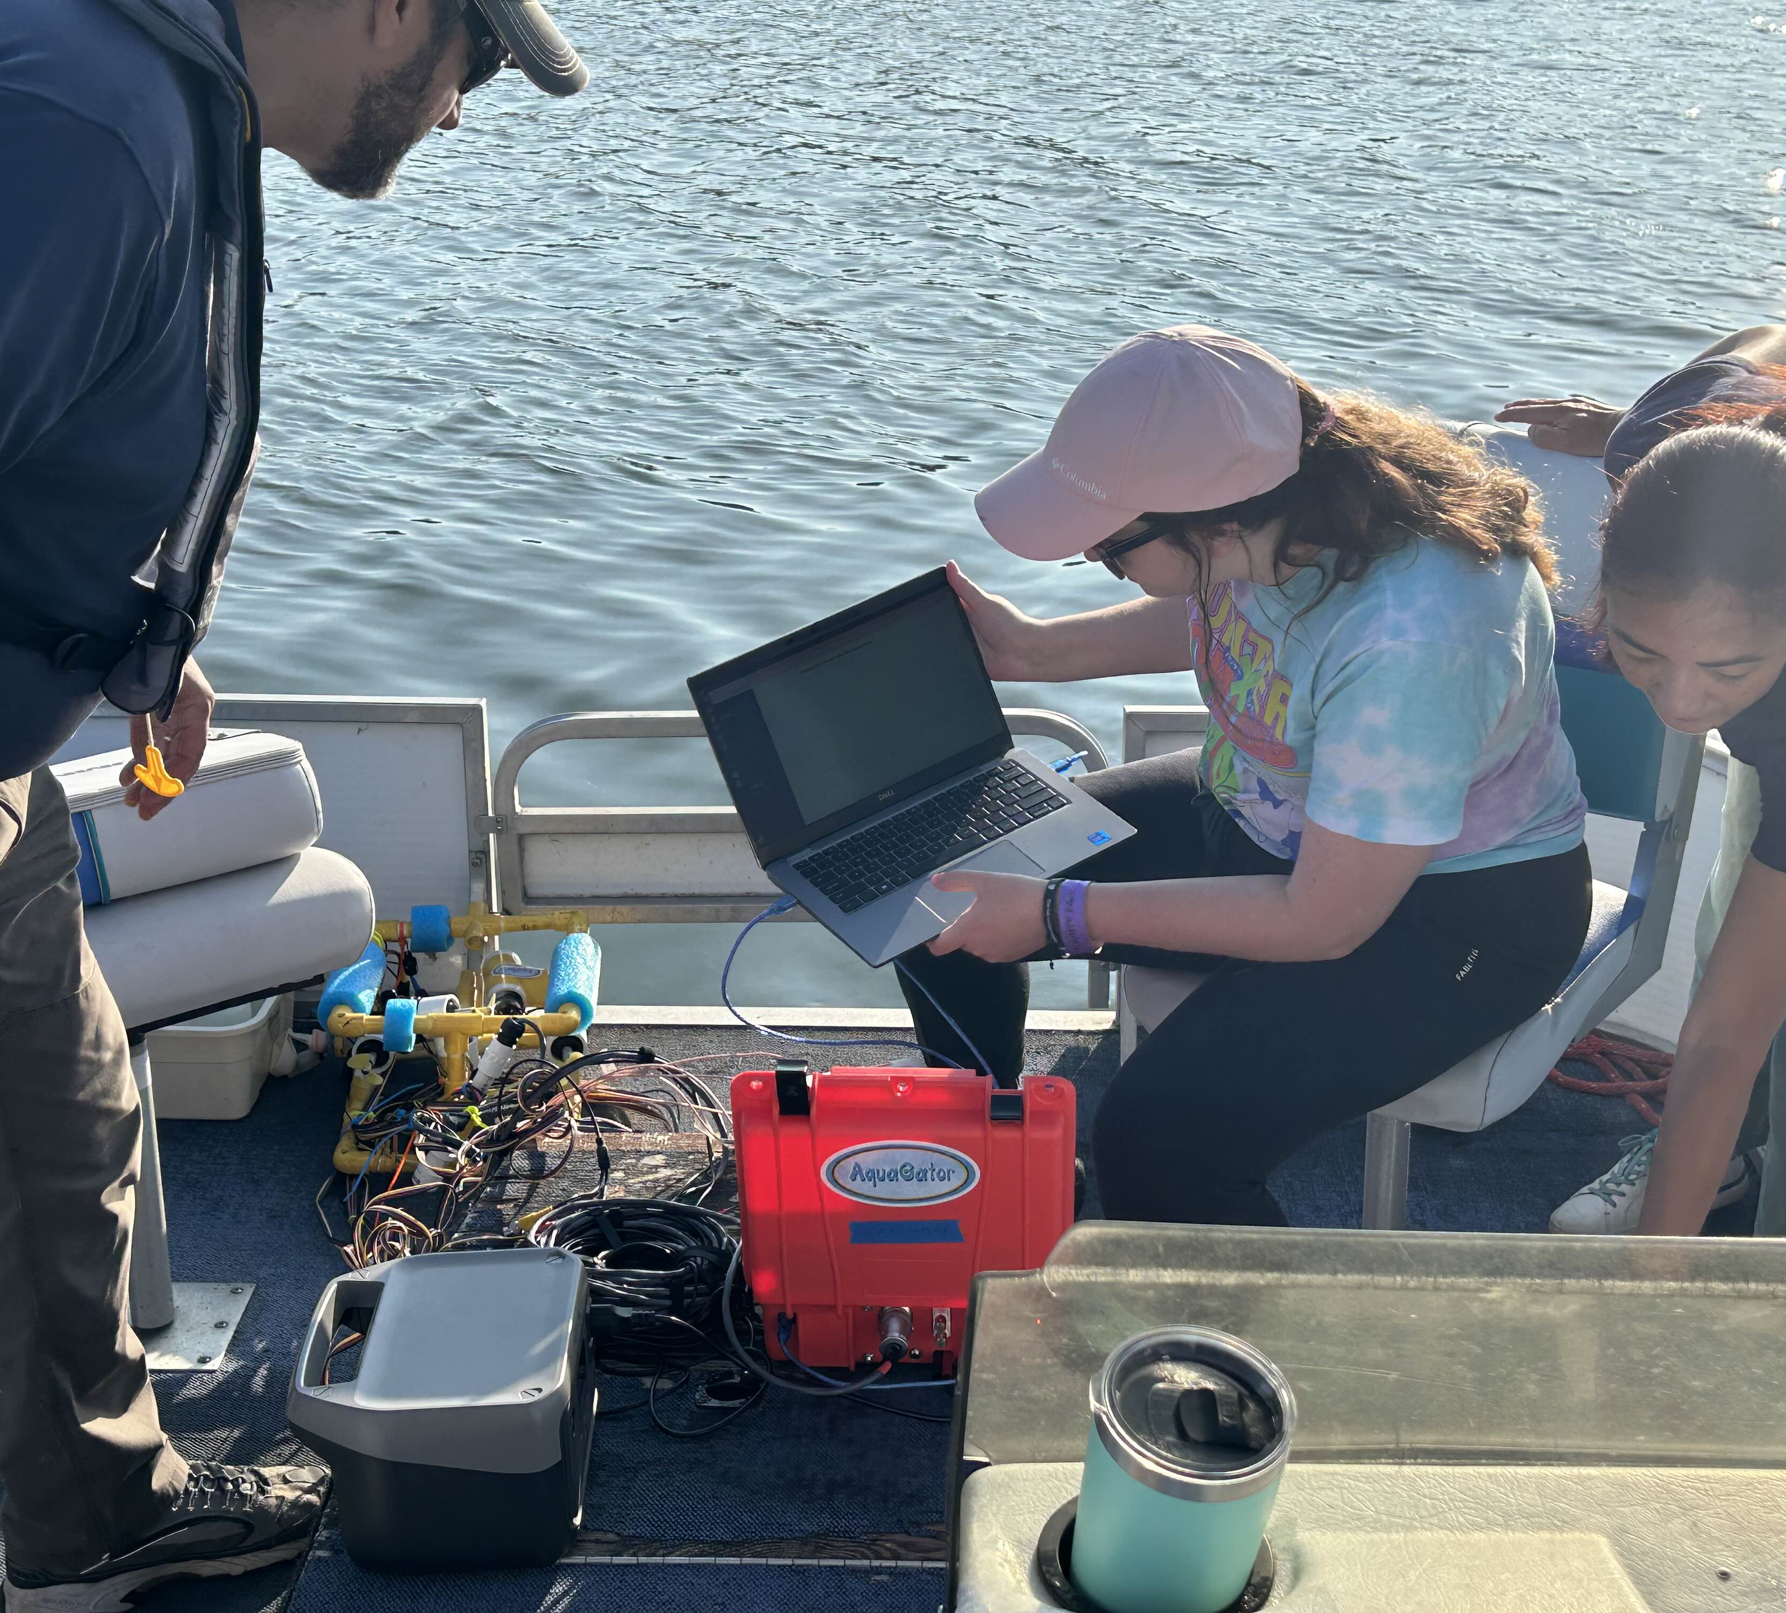

Slide 18
FUTURE WORK
Integrate AI Analysis with Outside Data
NOAA Radar – Forecast
Video Capture
Visual Analysis – Computer Vision
Collaborations

Slide 19
WORK CITED
Grattan, L. M.; Holobaugh, S.; and Morris Jr, J. G. 2016. Harmful algal blooms and public health. Harmful algae 57:2–8. Moore, S.; Bohm, H.; Jensen, V.; and Johnston, N. 2010.
Underwater robotics. Science, Design and Fabrication. Marine Advanced Technology Education Center (MATE), Monterrey CA, USA.
Paerl, H. W.; Havens, K. E.; Hall, N. S.; Otten, T. G.; Zhu, M.; Xu, H.; Zhu, G.; and Qin, B. 2019. Mitigating a global expansion of toxic cyanobacterial blooms: confounding effects and challenges posed by climate change. Marine and
Freshwater Research 71(5):579–592.

Slide 20
IMAGES CITED
[1] Marilyn Black, For the Times-News. 2021. Woodcock Creek Lake slowly regaining water levels after dam mishap; fish kill believed minimal. Erie Times-News. Retrieved November 2, 2024 from https://www.goerie.com/story/sports/outdoors/2021/03/13/woodcock-creek-lake-regaining-water-levels-fish-kill-believed-minimal/4680876001/
[2]sitebreed. 2021. Pymatuning Lake. Visit Crawford County, PA. Retrieved November 2, 2024 from https://visitcrawford.org/theres-a-story-here-pymatuning-lake/
[3]Contributors to Wikimedia projects. 2024. Conneaut Lake. Wikipedia. Retrieved November 2, 2024 from https://en.wikipedia.org/wiki/Conneaut_Lake
[4]A S. 2023. Tamarack Lake Meadville PA 2022. YouTube. Retrieved November 2, 2024 from https://www.youtube.com/watch?app=desktop&#38;v=Pt0-GtCZByo
[5]Surface Water Quality Monitoring. Water Monitoring. Retrieved November 2, 2024 from https://www.ysi.com/applications/surface-water [6]2010. Water Quality Monitoring in the Sound and Embayments. Long Island Sound Study. Retrieved November 2, 2024 from https://longislandsoundstudy.net/research-monitoring/water-quality-monitoring/
[7]Nick Walter. 2024. How extensive is CAP water quality testing at Lake Pleasant? Think 175 feet deep. Central Arizona Project. Retrieved November 2, 2024 from https://knowyourwaternews.com/how-extensive-is-cap-water-quality-testing-at-lake-pleasant-think-175-feet-deep/
[8]Water Quality Buoy. Mallows Bay National Marine Sanctuary. Retrieved November 2, 2024 from https://mallowsbay.marinesanctuary.org/hotspot/water-quality-buoy/

Slide 21
Thank You

